Slide 1
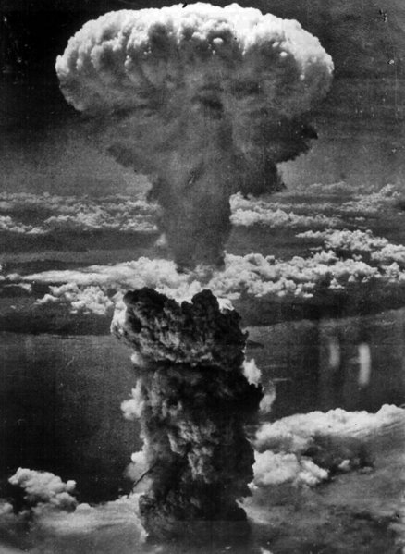

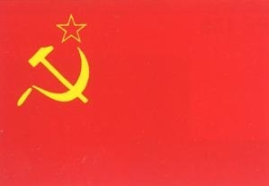
The Cold War:
Origins to 1960

Slide 2

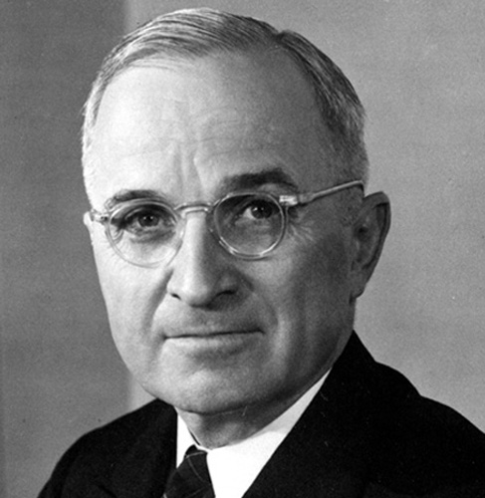
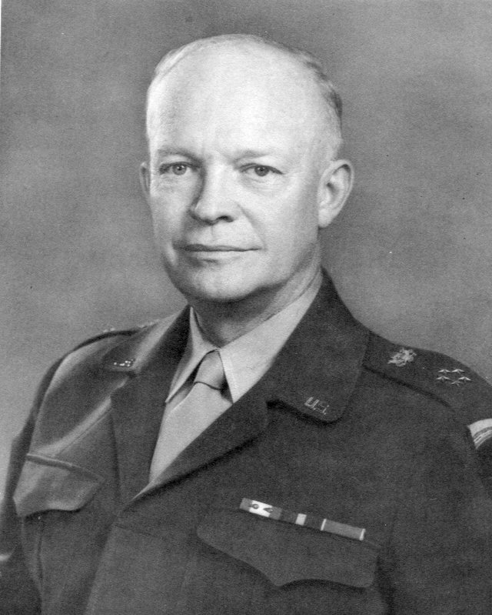
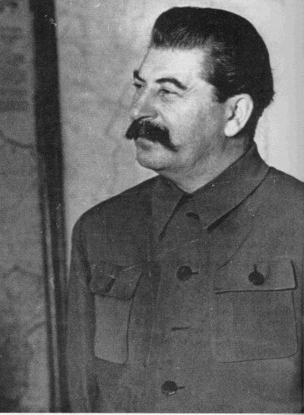
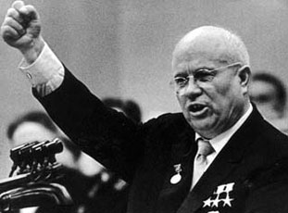
Background:
After WW II, the US and USSR emerged as rival superpowers.
Each nation was strong enough to greatly influence world events.

Slide 3
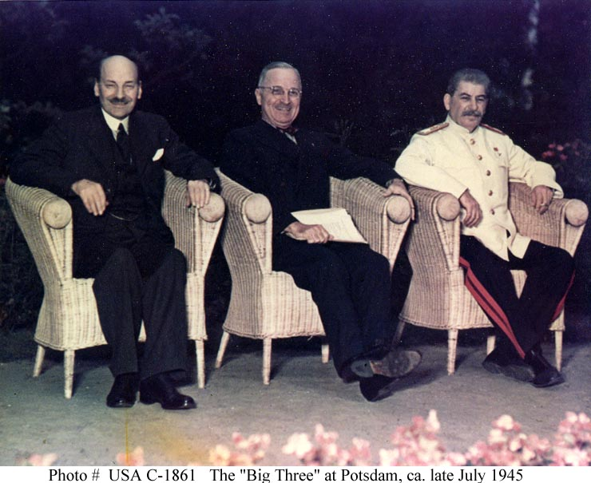
Potsdam Conference
July 1945
Final wartime conference
Big Three
  England = Attlee
  USA = Truman
  USSR = Stalin
Stalin promised to allow free elections in Eastern Europe
Notes:
At this stage the soviet Union occupied all of eastern Europe. The allies had developed the atomic bomb. Stalin wanted to place heavy reparations on Germany, Truman wanted to not make the same mistake again. 20 million Russians had died in WW2. Stalin wanted to cripple Germany economically.

Slide 4
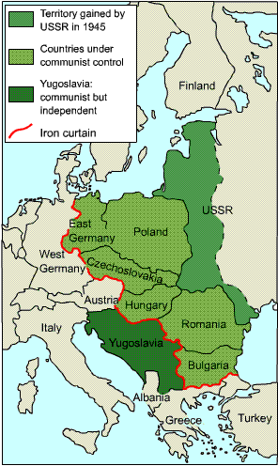
Satellite Nations…
Stalin never allowed truly free elections.
Instead, communist governments were installed in many Eastern European nations.
Main Purpose?
  Protect USSR from invasion from the West
Notes:
Secret police imprisoned those that may oppose communist rule. October 1947 Stalin set up the cominform to co-ordinate the work of the communist parties east of Europe. He made sure all leaders were completely loyal to him.

Slide 5
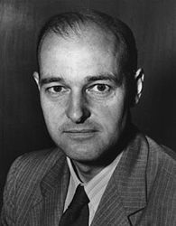
Containment Policy
George Kennan, career Foreign Service Officer
Formulated the policy of “containment”:
  US would not get rid of communism, but would not allow it to spread.
  US would “contain” communism where is already existed.
Notes:
Kennan was minister for affairs in Russia. This would shape Americia’s foreign policy. He was convinced that Roosevelts policy of friendliness was misplaced.

Slide 6
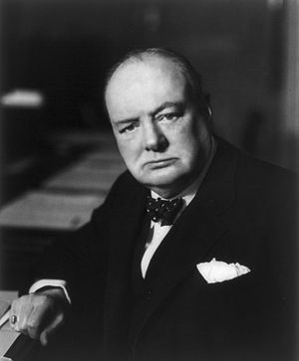
The Iron Curtain
Winston Churchill coined this term.
Famous speech on March 5, 1946 at Westminster College, in Fulton, Missouri.
Notes:
Speech heightened Soviet fears and pushed Stalin into a defensive and hostile stance. Churchill wanted to influence American policy.

Slide 7
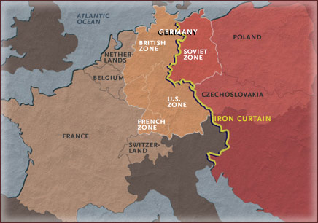

Slide 8
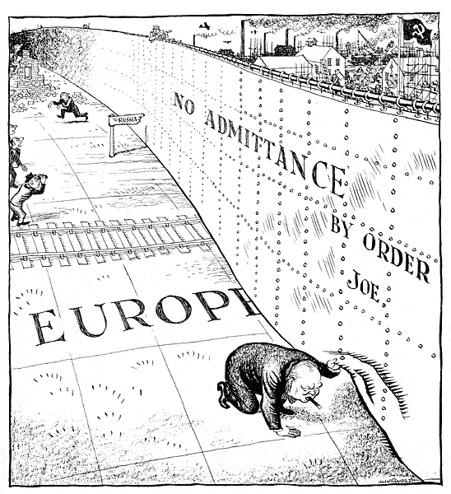

Churchill’s Warning…
Churchill felt that behind the Iron Curtain, the USSR was planning to attack and conquer Western Europe.

Slide 9
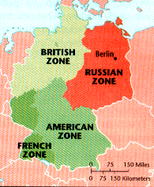
Division of Germany
The Allies decided to divide Germany into 4 zones after the war.
Also, the capital of Berlin was divided into 4 sectors.

Slide 10
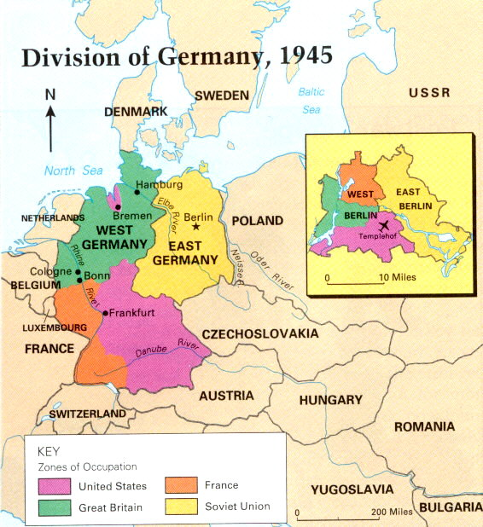

Slide 11
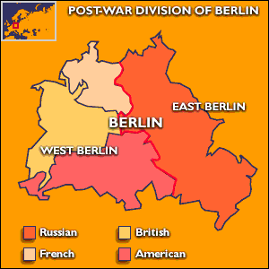

Slide 12
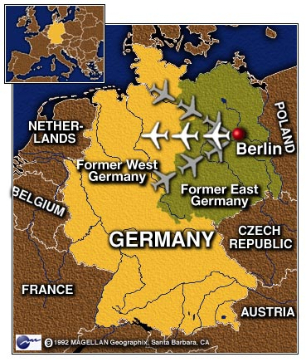

Problem with Berlin?
Berlin was in the Soviet Sector.
Stalin was not happy with a “small piece” of democracy in Eastern Europe.
Notes:
USA, Britain and France combined their zones in 1946 to form one zone. In 1948 there were signs the german economy was recovering.

Slide 13

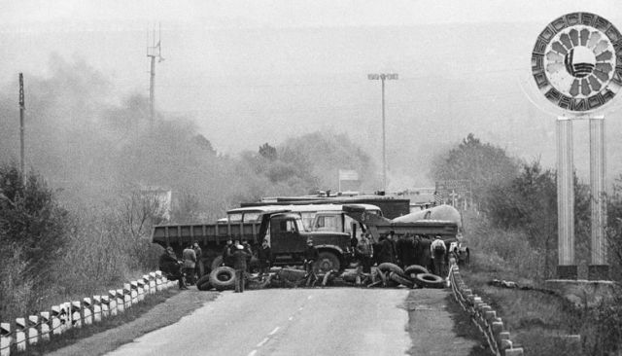
Berlin Blockade
June 1948, Stalin attempts to starve West Berliners into submission.
All rail and street access was blocked.
Notes:
If the U.S rammed the blockades it would be seen as an act of war.

Slide 14
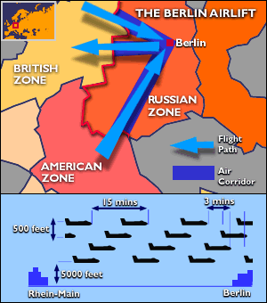
Berlin Airlift
American and British planes flew food and supplies into Berlin for 327 days.
Stalin lifted the Blockade by May 1949.

Slide 15
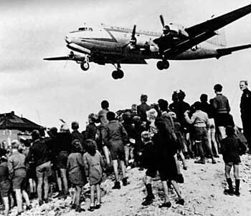
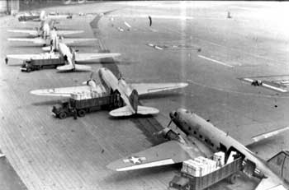
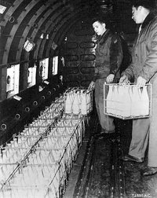
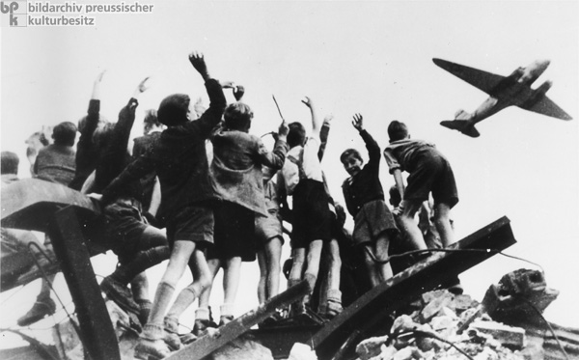

Slide 16
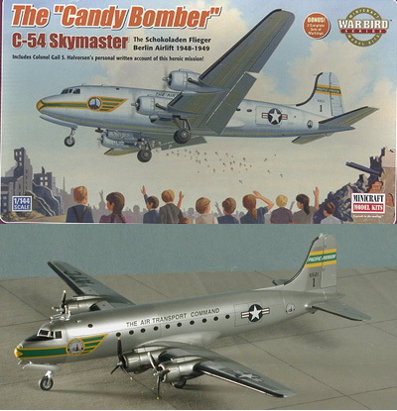
Operation “Little Vittles”
During the Berlin Airlift a group of pilots decided to help boost the spirits of the German children.
They organized a mission to drop candy to the children using parachutes made of handkerchiefs.

Slide 17
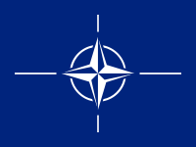
North Atlantic Treaty
Organization
NATO was established by a treaty in 1949
This organization established a system of collective defense whereby its member states agree to mutual defense in response to an attack by any external party.
Original members were:
  United States, the United Kingdom, Canada, France, Denmark, Iceland, Italy, Norway, Portugal, Belgium, Netherlands, and Luxembourg.
  Greece (1952), West Germany (1955) join also

Slide 18

The Warsaw Pact
Communist Response to NATO.
  Signed on May 1, 1955 in Warsaw, Poland
Military treaty, which bound its signatories to come to the aid of the others, should any one of them be the victim of foreign aggression.
Original Members:
  Albania, Bulgaria, Hungary, East Germany, Poland, Rumania, the USSR, and the Czechoslovak Republic.

Slide 19
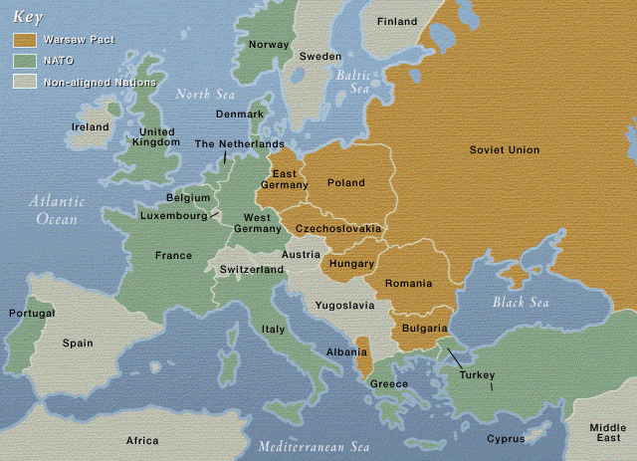

Slide 20
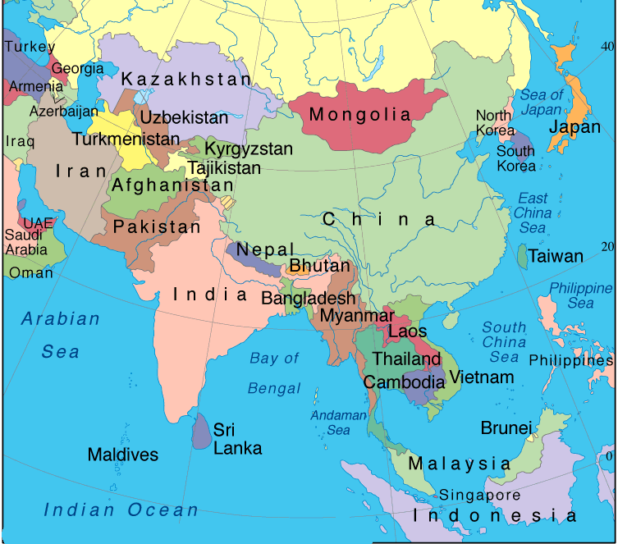
Cold War in Asia

Slide 21


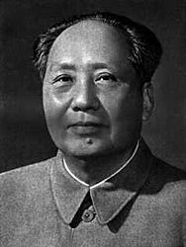
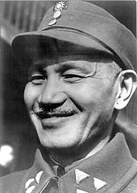
Struggle for China
Mao Zedong wanted China to become a communist state after WW II.
Chang Kai Shek fought to stop the communists but was unsuccessful.

Slide 22

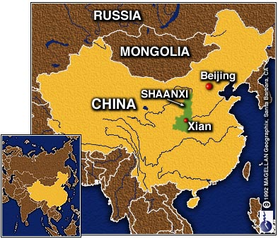
Communist China
1949

